Slide 1
FOOD ORDERING SYSTEM
610557 Munkhzorig Bayartosgt
610561 Tuvshintur Batzorig
610567 Davaaabayar Battogtokh
610526 Odbayar Nanjidjamts
961800 Manduul Enkhee
MUM CS472-2019-11A-11D
1
Maharishi University of Management
Notes:
1

Slide 2
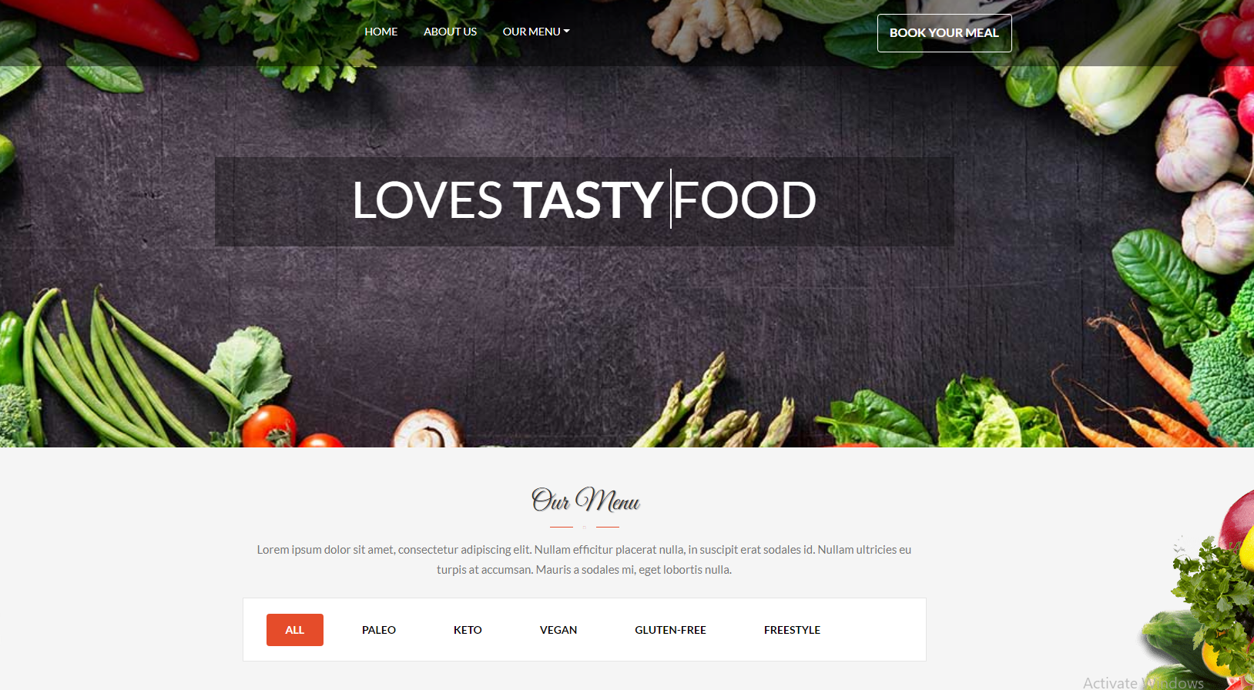
1. Project Description
Food Ordering System for people who
Loves tasty food
Loves quality food
Loves healthy food
Features
Foods has meal type and calories information
Filter foods based on meal preference
Place order
Two types of user role
Admin user which will manage orders and create menus.

Slide 3
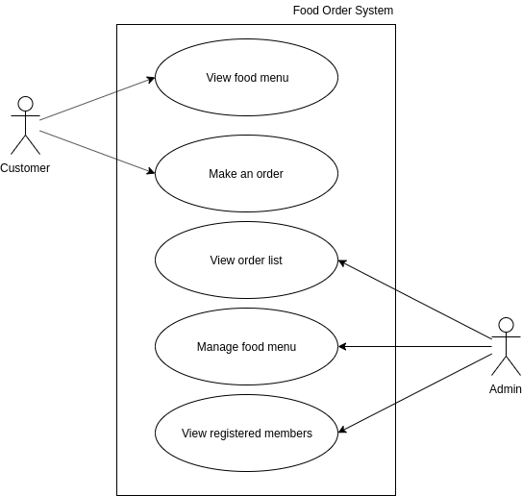
2.Use case diagram
3

Slide 4
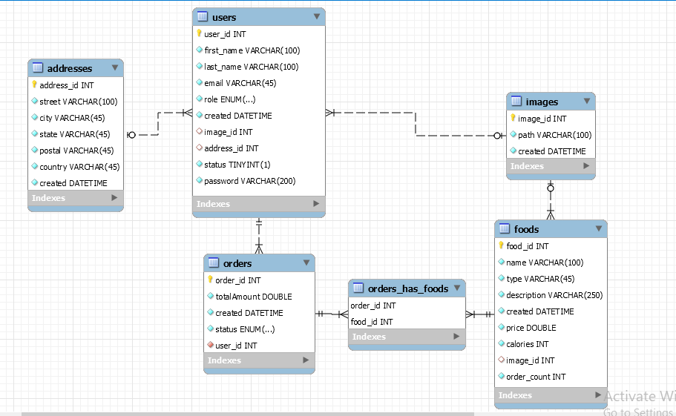
3. Key abstractions vs ERD
Foods
Users
Addresses
Orders
Orders_Has_foods
Images
4

Slide 5
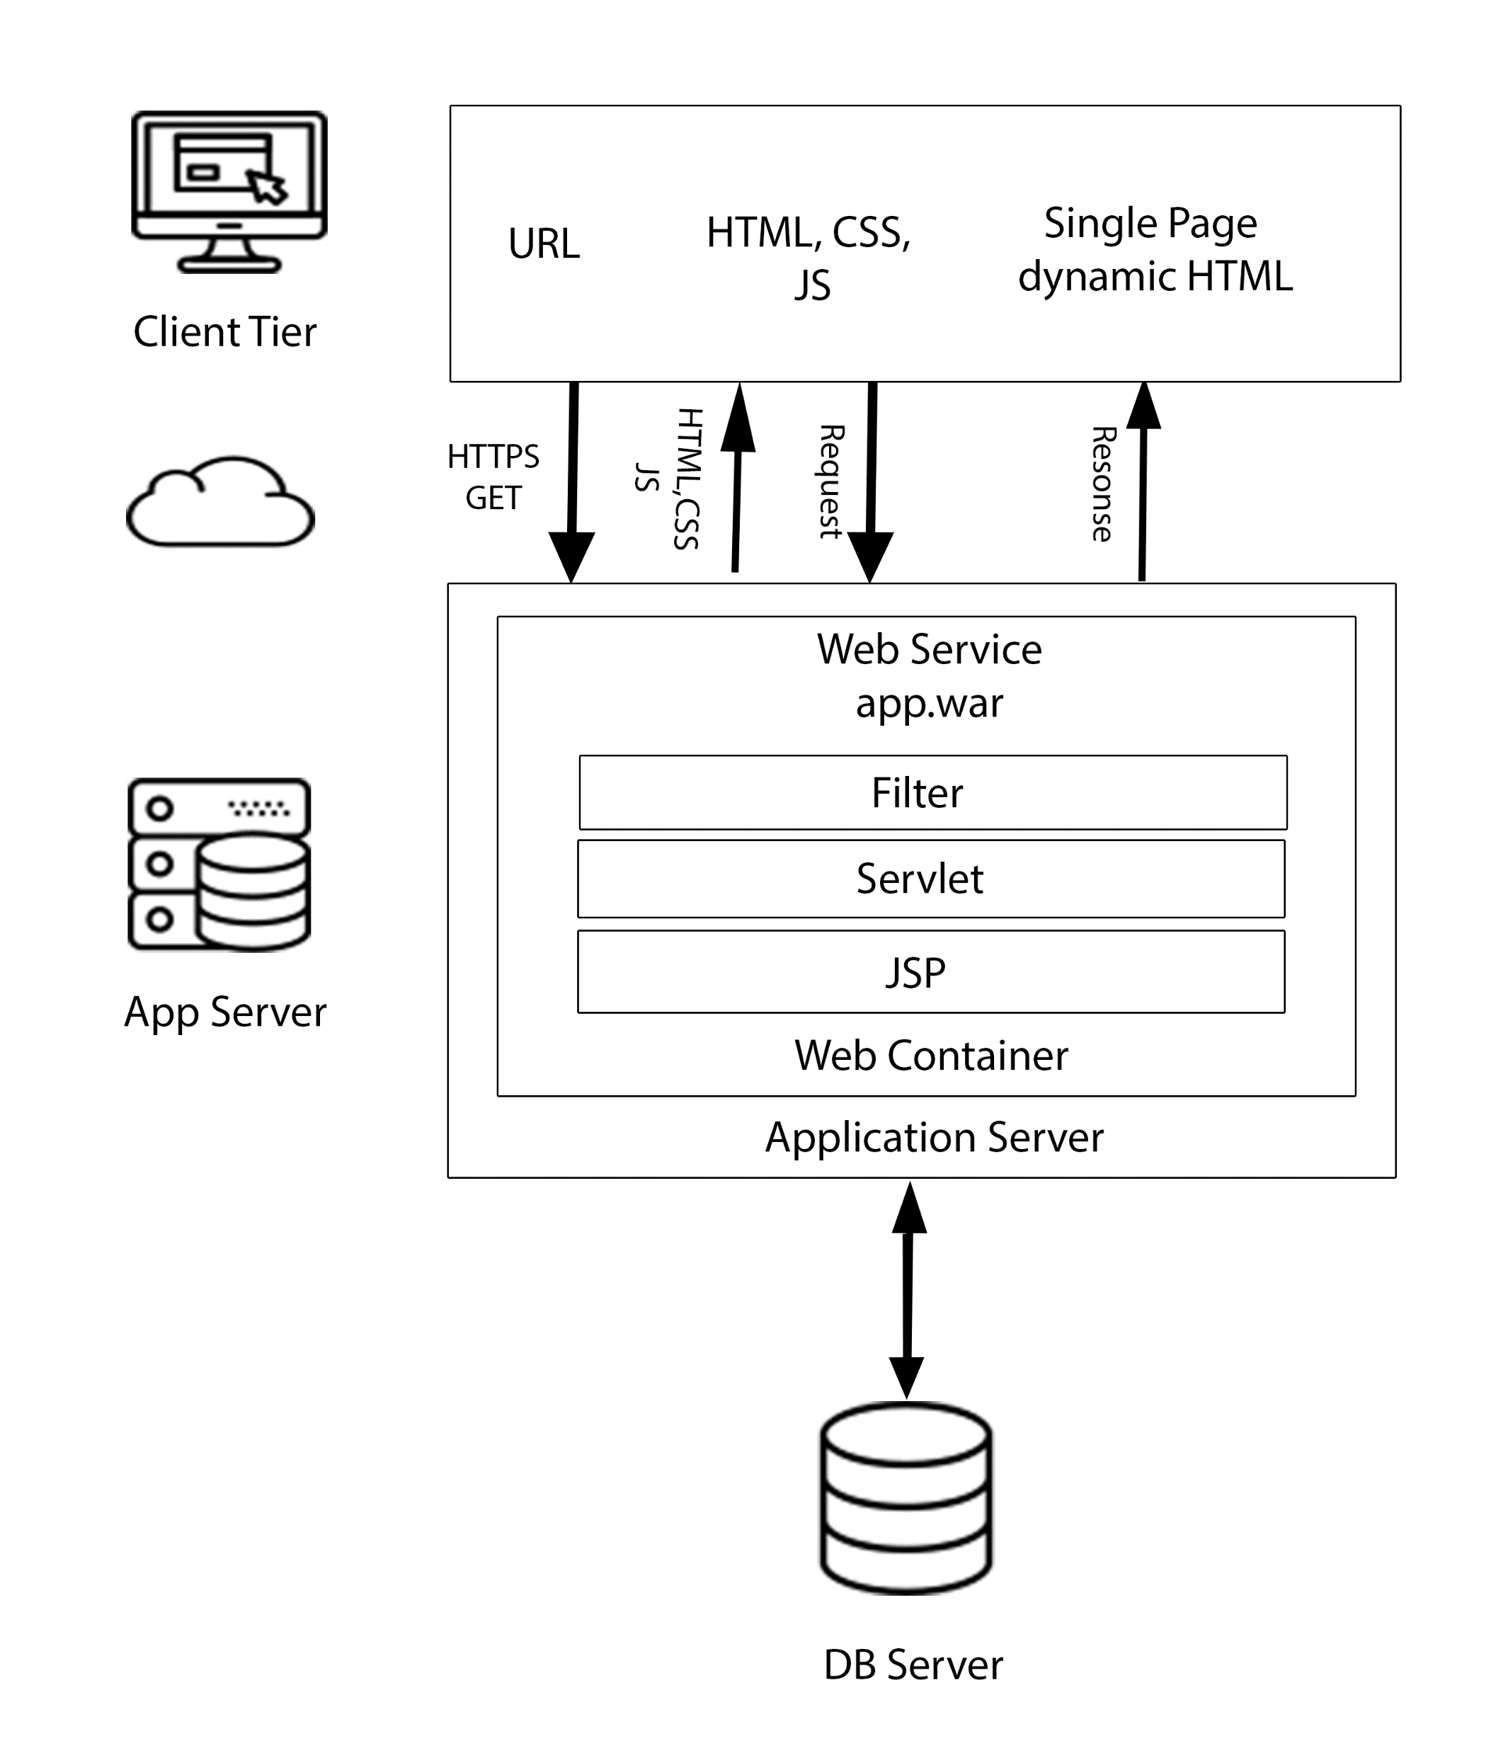



4. High level architecture & Technologies used
5

Slide 6
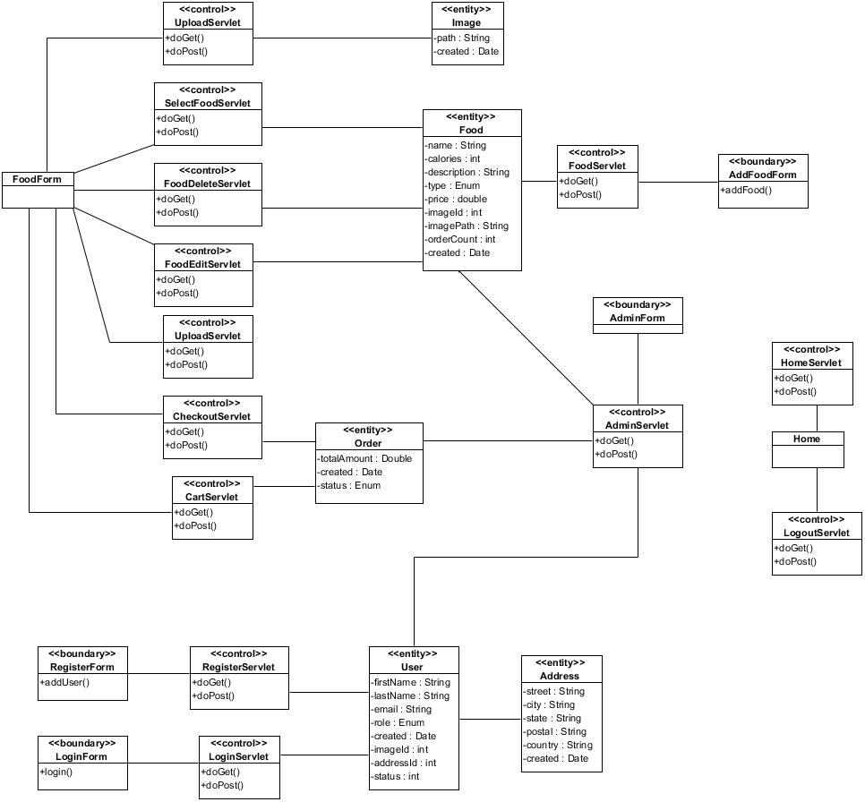
5. Class Diagram
6

Slide 7
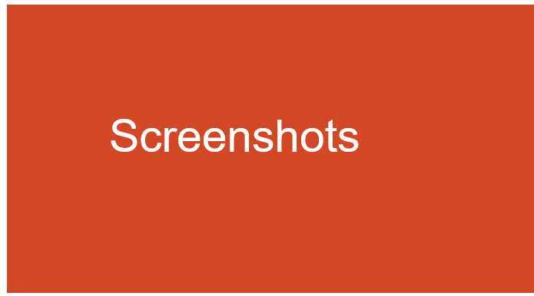
Screenshots

Slide 8
Thank you
Get a little bit of better
every single day.
MUM CS472-2019-11A-11D
8
Maharishi University of Management
Notes:
In Slide Show mode, click the arrow to enter the PowerPoint Getting Started Center.
8

